Slide 1
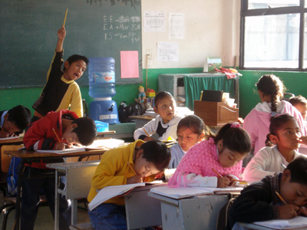
Progresa and School Attendance: Do Conditional Cash Transfers Improve School Attendance?
By
Adam Parente

Slide 2
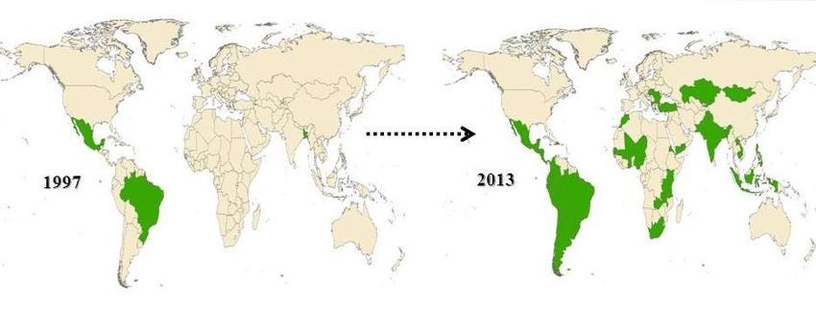
Progresa and Shultz(2004)
Progresa is a Mexican conditional cash transfer program from the late 1990s aimed partially at school attendance.
Started a trend of randomized control trials within development economics (IFPRI)
Researchers set up control and treatment groups
Figure by Omar Ben Haman (IJRISS)

Slide 3
The Dataset
This analysis is with a sample of the original dataset
Important variables are:
Attendance
Treatment
Poor (welfare eligible)
Bias from attrition and movement, but this is more prevalent for the multiyear study

Slide 4
Hypothesis
School attendance improves when the program (treatment) is implemented
Comparison between treatment and control
Comparison across time
Look at village level aggregates and individuals

Slide 5
Comparing Treatment and Control
 | 1997
 | Control Mean | Treatment Mean | Difference
Sex | 0.503639 | 0.517562 | 0.013923
Indigenous | 0.29704 | 0.299126 | 0.002086
School Distance | 2.455722 | 2.39593 | -0.059792
Grade | 3.71546 | 3.699075 | -0.016385
Family size | 7.236309 | 7.20286 | -0.033449
Distance to city | 101.2408 | 104.8251 | 3.584272
Head of Household Education | 2.719097 | 2.798696 | 0.079599
Head of Household Wage | 603.7344 | 576.5294 | -27.204997
Head of Household Sex | 0.922994 | 0.926552 | 0.003558
Head of Household Age | 44.76981 | 44.22876 | -0.541046
Age | 10.88926 | 10.85223 | -0.037027
Poor | 0.840283 | 0.850378 | 0.010095
Treatment and Control groups are similar
Statistically significant, but no magnitude
1998 means are near identical

Slide 6
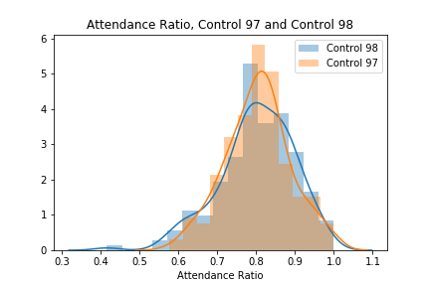
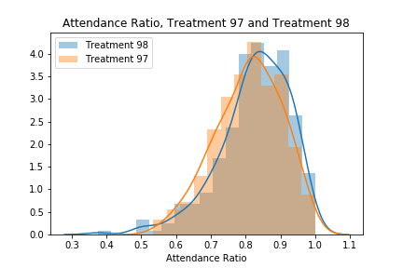
Attendance Ratio (Time)
Not statistically different
Statistically Different
For a village with 100 students, up to 3 more students attend school

Slide 7
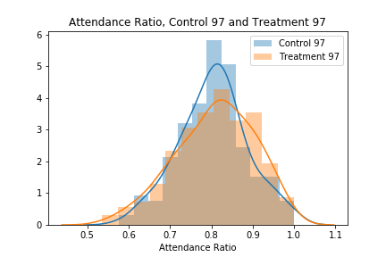
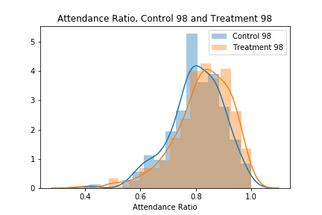
Attendance Ratio (Treatment)
Not statistically different
Statistically Different
For a village with 100 students, up to 4 more students attend school

Slide 8
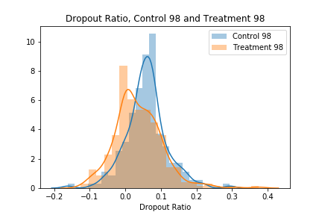
Dropout Ratio (Treatment)
Statistically Different
Negative values show that additional students enrolled
For a village with 100 students, about 1 less student drops out.

Slide 9
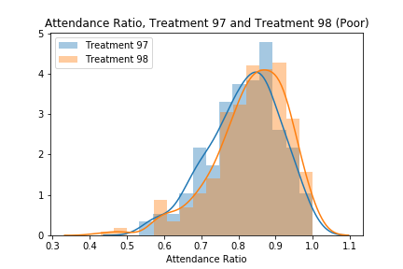
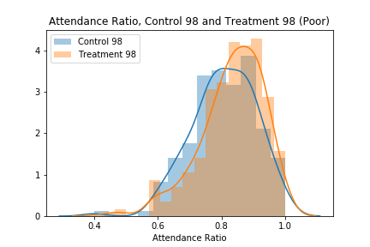
Welfare Eligible Students
Statistically Different
For a village with 100 poor students, up to 3 more students attend school
Statistically Different
For a village with 100 poor students, up to 4 more students attend school

Slide 10
Individuals
97 |  |  |  | 98
Attending | Control | Treatment | All | Attending | Control | Treatment | All
No | 2723 | 4104 | 6827 | No | 2419 | 3150 | 5569
 | 7.42% | 11.19% | 18.61% |  | 7.53% | 9.81% | 17.34%
Yes | 11355 | 18507 | 29862 | Yes | 9855 | 16684 | 26539
 | 30.95% | 50.44% | 81.39% |  | 30.69% | 51.96% | 82.66%
All | 14078 | 22611 | 36689 | All | 12274 | 19834 | 32108
 | 38.37% | 61.63% | 100.00% |  | 38.23% | 61.77% | 100.00%

Slide 11
Comparing Crosstabs
Difference (Pop Adjusted)
Attending | Control | Treatment | All
No | 35.99 | -441.57 | -405.6
 | 1.49% | -14.02% | -7.28%
Yes | -82.21 | 487.79 | 405.58
 | -0.83% | 2.92% | 1.53%
All | -46.22 | 46.22 | 0
 | -0.38% | 0.23% | 0.00%
The difference between 98 and 97(adjusted) is statistically significant
About ~450 more students attended class than expected for the treatment group
The control group had a slight decline in attendance
Percentages are the % difference between 98 and 97 (adjusted)

Slide 12
Conclusion
Clear demonstration of the difference the introduction of CCTs makes for school attendance
Control variable means are similar
Multiple different tests of the treatment effect are significant
Small effect on larger population, larger effect on targeted subpopulation

